Slide 1
Popularity based Recommender System

Slide 2
Why do we need recommender systems?
They help the user find items of their interest
Helps the item provider to deliver their items to the right use
To identify the most relevant products for each user
Showcase personalised content to each user
Suggest top offers and discounts to the right user
Websites can improve user-engagement
It increases revenues for business through increased consumption

Slide 3
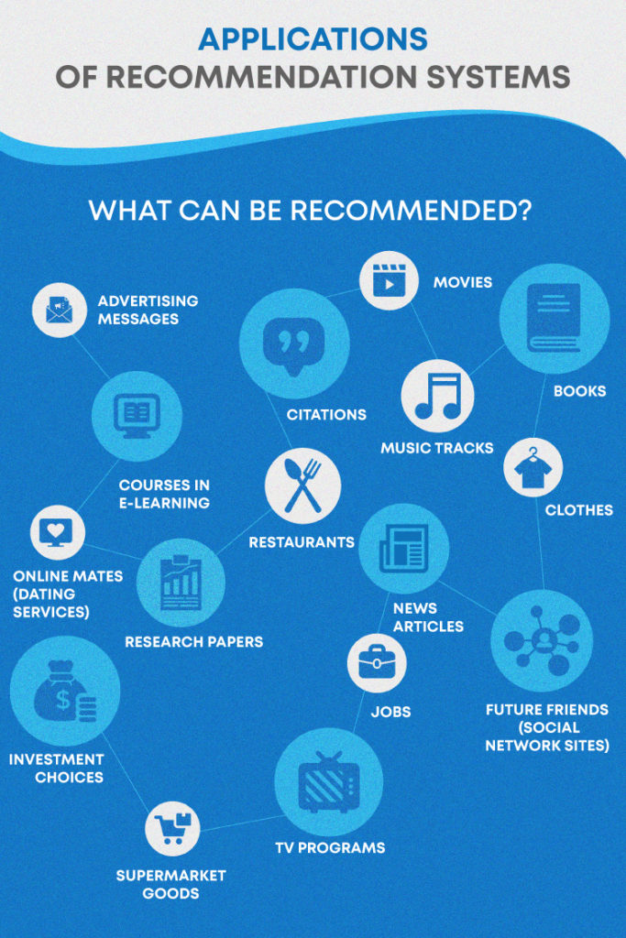

Slide 4
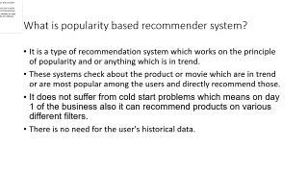
What is popularity based recommender system?
It is a type of recommendation system which works on the principle of popularity and or anything which is in trend.
These systems check about the product or movie which are in trend or are most popular among the users and directly recommend those.
It does not suffer from cold start problems which means on day 1 of the business also it can recommend products on various different filters.
There is no need for the user's historical data.

Slide 5
Building the popularity based recommender system
Here, in this model, we are using weighted average method to build a basic model to represent the popularity of the movies dataset.

Slide 6
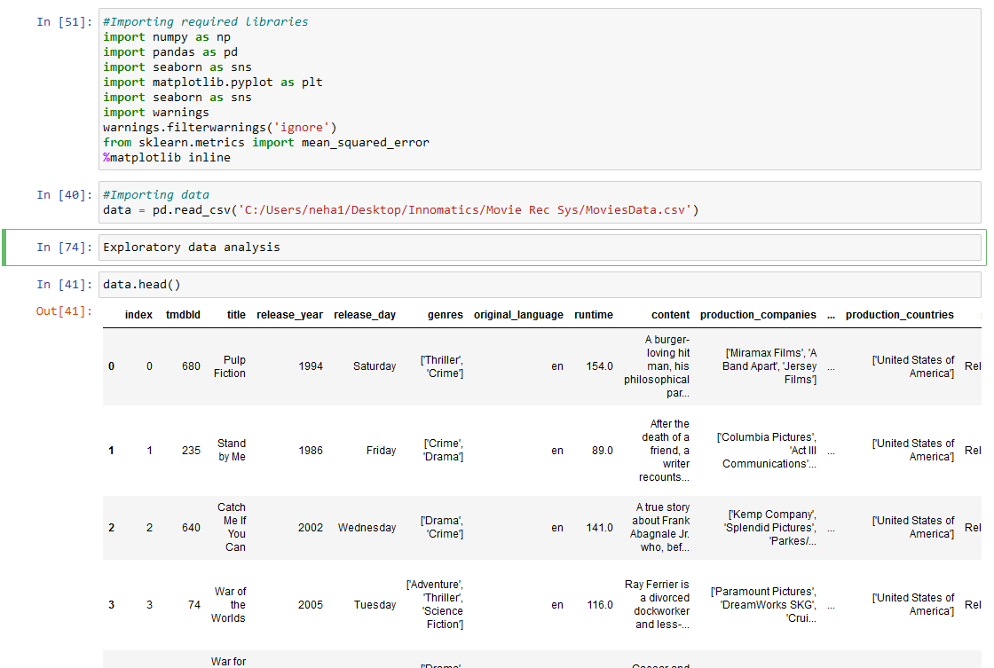
Importing libraries and understanding the data

Slide 7
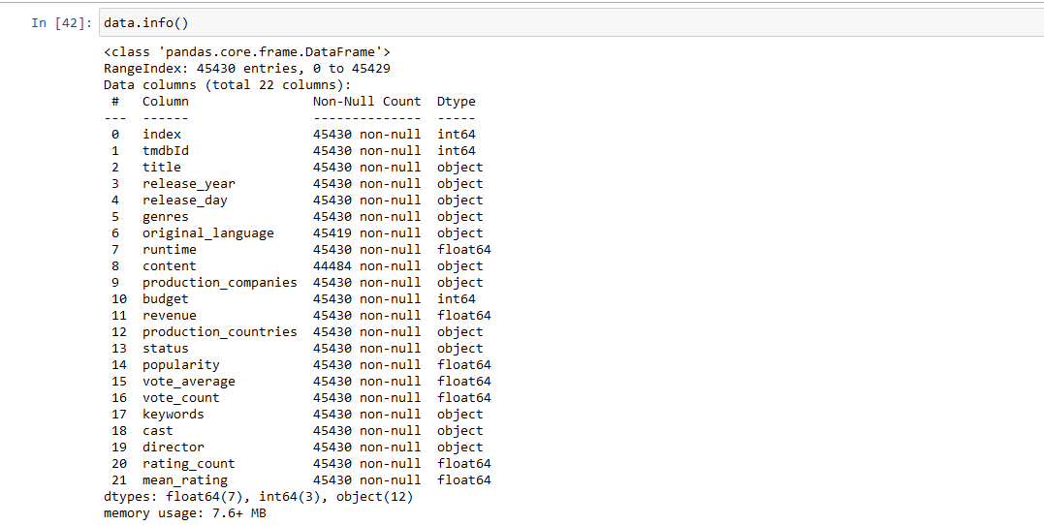
Exploratory data analysis

Slide 8
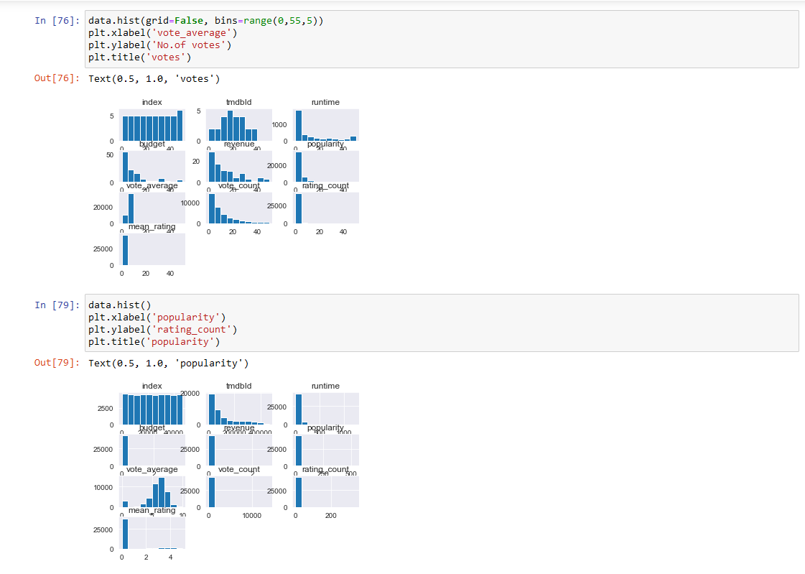
Relation between popularity and other attributes of the data

Slide 9
Interpretations
In the first graph, we tried to group the data, based on each attribute, against the votes of the movies.
In the second graph, we grouped the data, based on popularity and vote count

Slide 10
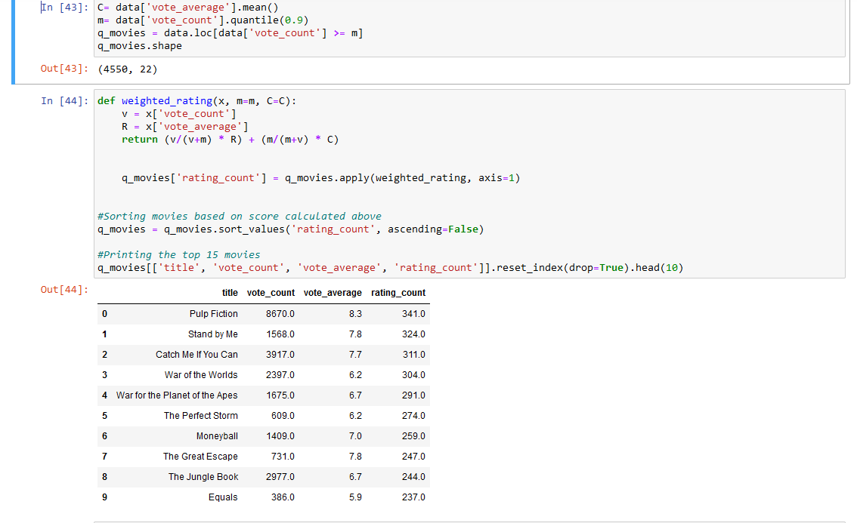
Application of the weighted average model Here we used 90th percentile as our cutoff. In other words, for a movie to feature in the charts, it must have more votes than at least 90% of the movies in the list.

Slide 11
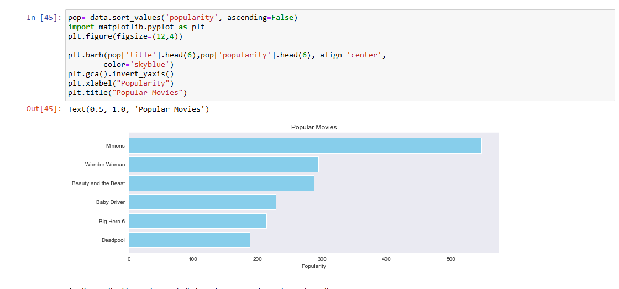
Visualizing the model

